Slide 1
Some and any
Basic 05 – Unit 3a

Slide 2
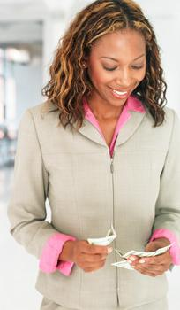
7-8 USING SOME AND ANY
Alice has some money.

Slide 3
7-8 USING SOME AND ANY
STATEMENT
(a) Alice has some money.
(b) Alice doesn’t have any money.
(c) Does Alice have some money?
some in affirmative statements
NEGATIVE
any in negative statements
QUESTION
either some in questions to offer or request

Slide 4
7-8 USING SOME AND ANY
(e) Graham doesn’t have any money.
(f) Graham doesn’t have any coins.
noncount noun
plural count noun
any + noncount nouns
any + plural count nouns

Slide 5
7-8 Let’s Practice
some any
some
I need _____ time to study.

Slide 6
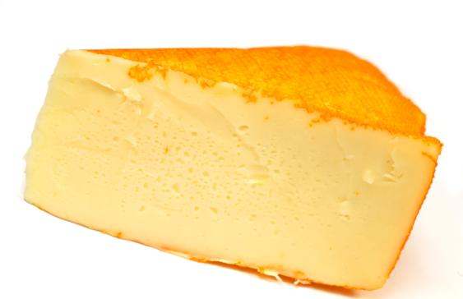
7-8 Let’s Practice
some any
We don’t have _____ cheese.
any

Slide 7
7-8 Let’s Practice
some any
some
All children should have _____ books.

Slide 8
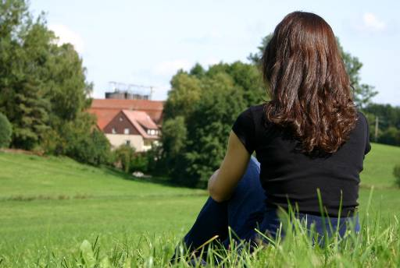
7-8 Let’s Practice
some any
any
There aren’t _____ horses in the field.

Slide 9
Some : affirmative sentences
Any : negative sentences, questions
I have some oranges
I need some lemons for my pie
I see some pens on the table
Do we need any yogurt?
Yes, we need some.
Do you have any bananas?
No, I don’t have any
No, I don have any bananas
Do we need any water?
No, we don’t need any.

Slide 10
Much : Uncountable nouns
Many : Countable nouns
How much money do you have?
I don’t have any money. ☹
How many oranges do you have?
I have two oranges. ☺

Slide 11
Time to practice ☺
Complete the sentences with some or any.
We need ______ bananas.
You can’t buy ____ apples in this store.
She always has _____ sugar for her coffee.
There are _____ onions on the table.
Pam does not have ____ juice in her glass.
Do you have _____ lucumas ?
Are there _____ magazines on the desk?
I want _____ salt for my avocado please.

Slide 12
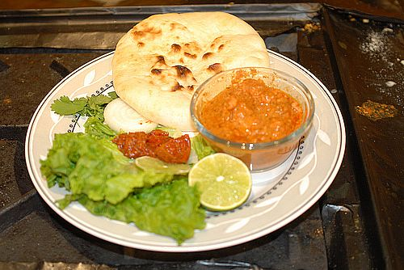
There is some food.

Slide 13
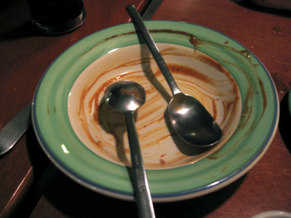
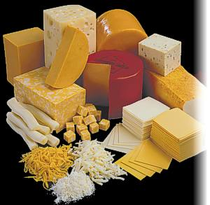
There isn’t any soup.
There is some white cheese.

Slide 14
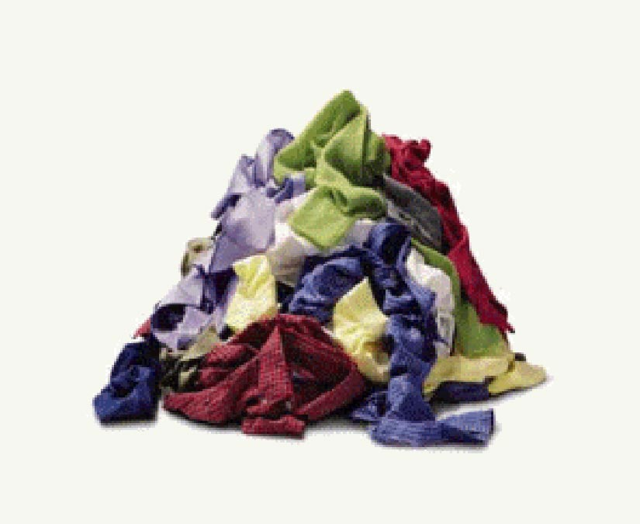
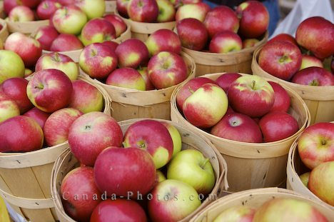
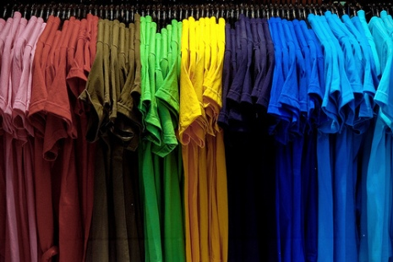
There are some yellow t-shirts
There aren´t any bananas

Slide 15
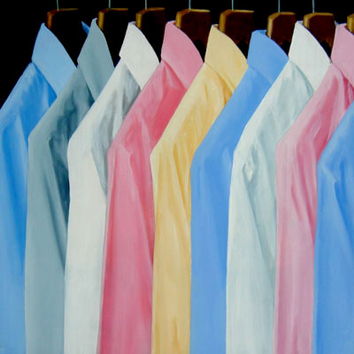
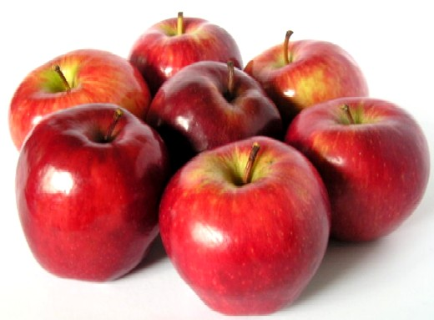
There are some shirts
There are some apples

Slide 16
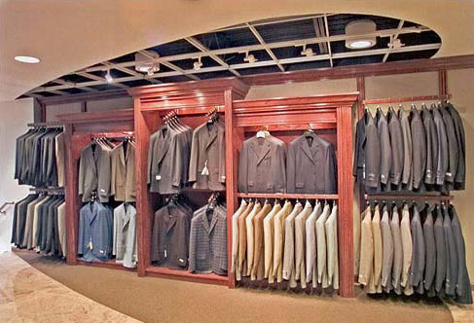
There aren’t any t-shirts

Slide 17
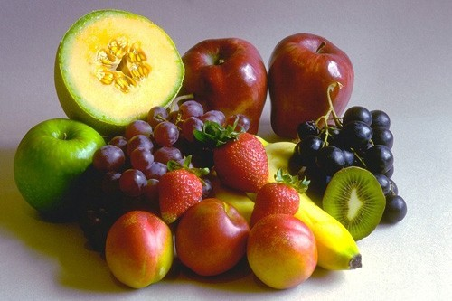
There is a lot of fruit on the table.

Slide 18
There aren’t any lucumas on the table.

